Slide 1
Visualization Rhetoric & Critique
JOUR479D/779D
University of Maryland
Nick Diakopoulos

Slide 2
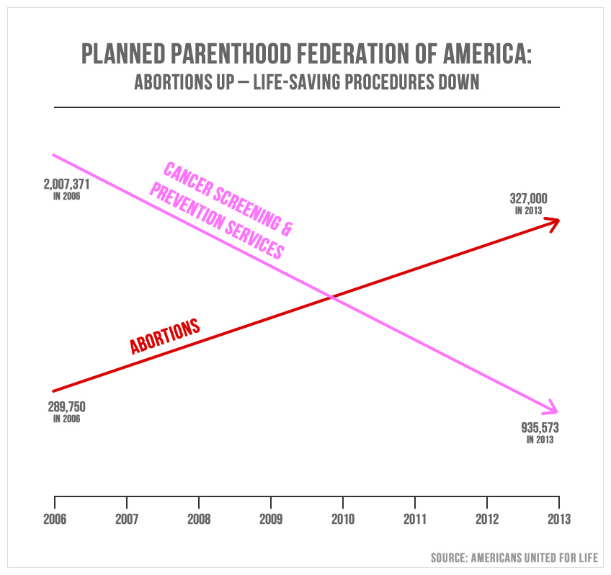
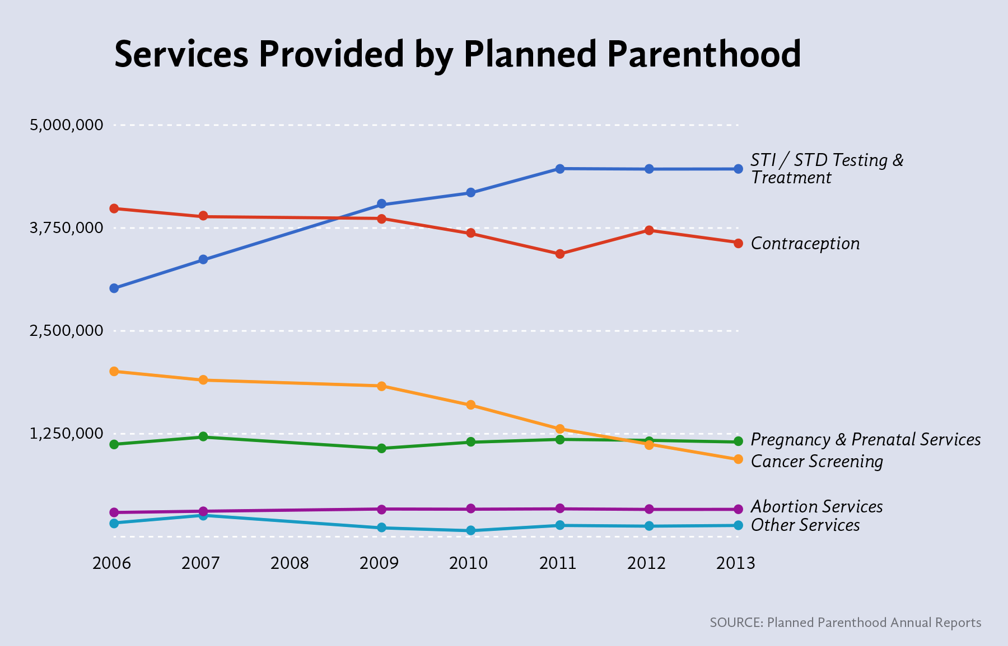
Notes:
Anyone see this graph published a few weeks ago? By Americans United for Life (AUL). this chart was shown briefly during a House government oversight committee on September 29th in which Cecile Richards, president of Planned Parenthood, was questioned by House Republicans.
What’s wrong with this chart? Different y-axes
Also: the American College of Obstetricians and Gynecologists started advising a reduction of frequency in 2009. Previously, women received a pap smear to screen for cervical cancer once a year, but it is now recommended that pap smears should be performed every three years. … so that explains the decline in cancer screenings.

Slide 3
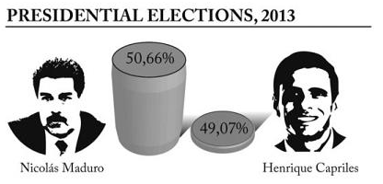
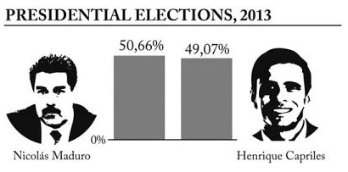
Graphical Integrity: Baselines
Source: Cairo. Graphics Lies, Misleading Visuals..
Notes:
Let’s start with some examples of misleading graphics and why they’re misleading.
The hope is that if you understand how graphics mislead then you can be more faithful in the way you create graphics by not making these mistakes.
Deceptive baseline. Because the top chart doesn’t start at 0% it distorts the height of the bars.

Slide 4
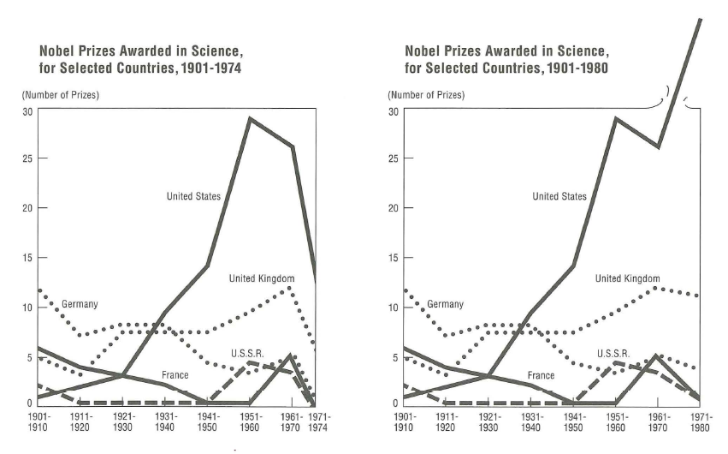
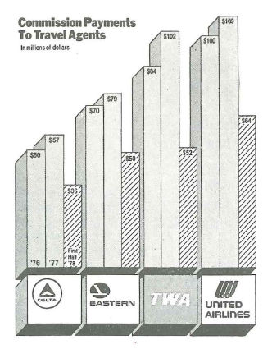
Graphical Integrity: Aggregates
Notes:
By showing a partial year, this bar chart portrays a false comparison or trend of things going down.
Aggregates can mislead.

Slide 5
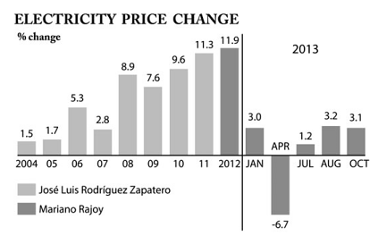
Graphical Integrity: Aggregates
Source: Cairo. Graphics Lies, Misleading Visuals..
Notes:
The units change from years to months and mislead you because you’re again comparing apples and oranges

Slide 6
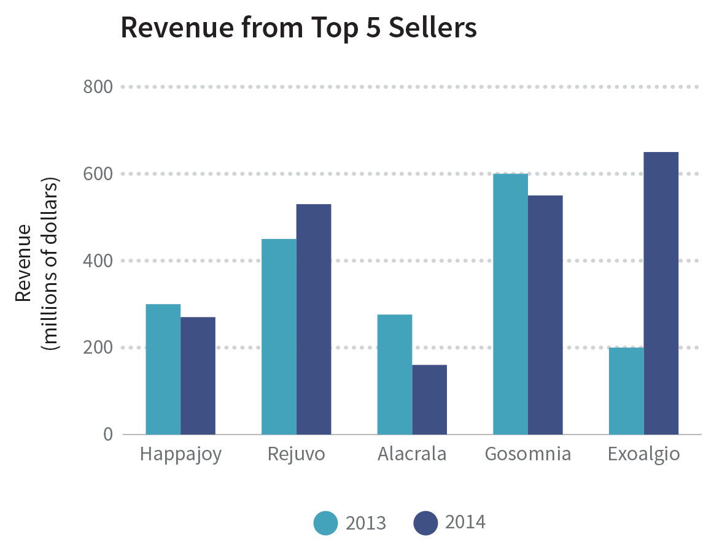
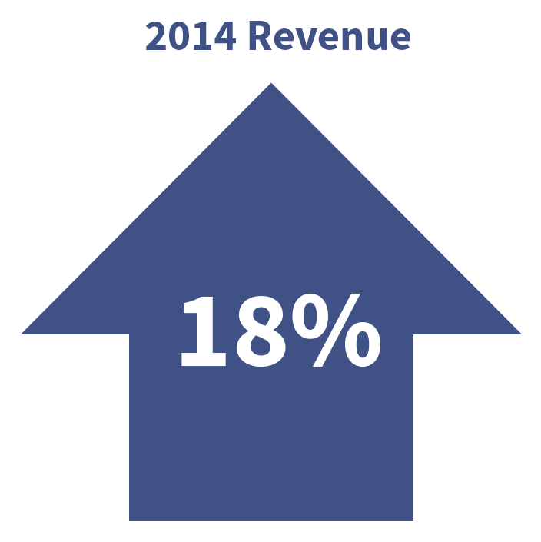
Graphical Integrity: Aggregates
Source: Data + Design. Chapter 18: Common Visualization Mistakes.
Notes:
By showing a partial year, this bar chart portrays a false comparison or trend of things going down.
Aggregates can be used to obfuscate, 18% increase, but in fact 3 of the sales figures decreased and 1 was a huge success. So the data can show a lot more nuance.

Slide 7
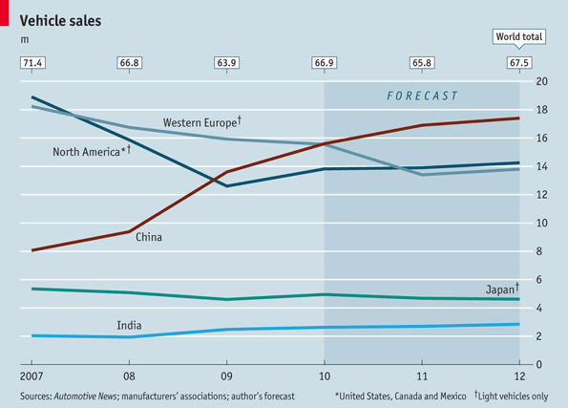
Graphical Integrity: Definitions
Notes:
The story the graph tells is pretty clear: Sales in China are rocketing up while they’re declining or stagnant in North America and Europe. But look more closely. The data for Western Europe and North America is defined as an aggregation of light vehicle sales, according to the note in the lower-right corner. How would the story change if the North American data included truck, SUV, and minivan sales? The story you get from these kinds of data graphics can depend entirely on what’s aggregated (or not aggregated) together in the measure. Aggregations can serve as a tool of obfuscation, whether intentional or not

Slide 8
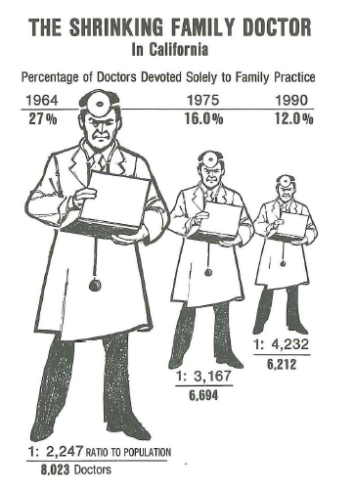
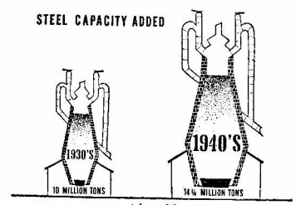
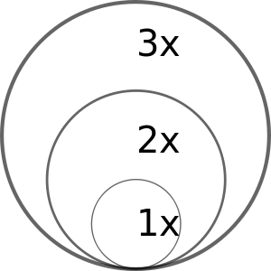
Graphical Integrity: Encoding
Notes:
If we map a data value to radius or diameter, the physical size of the circle goes up as a square. Instead consider scaling by the area of the symbol (a circle in this case).
The encoding of data into symbols in this vis of doctors devoted to family practice suffers the same issue: showing a 1 dimensions attribute as an area of the symbol leads to distortion.

Slide 9
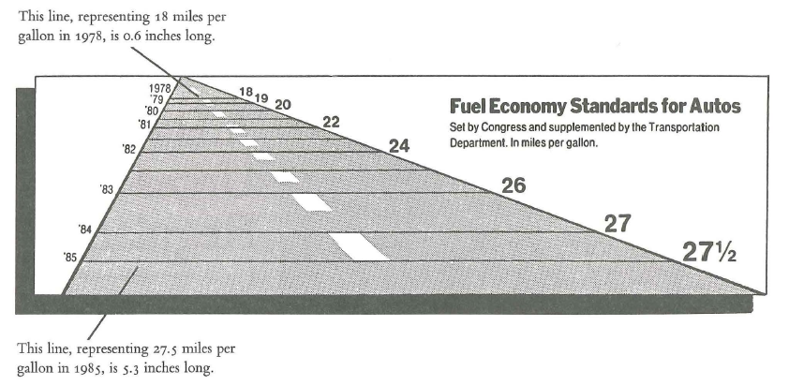
Graphical Integrity: Perspective
Notes:
Not only are years not uniformly spaced, but you have font sizes changing.
You can’t differentiate the difference in a change of value and in the perspective distortion

Slide 10
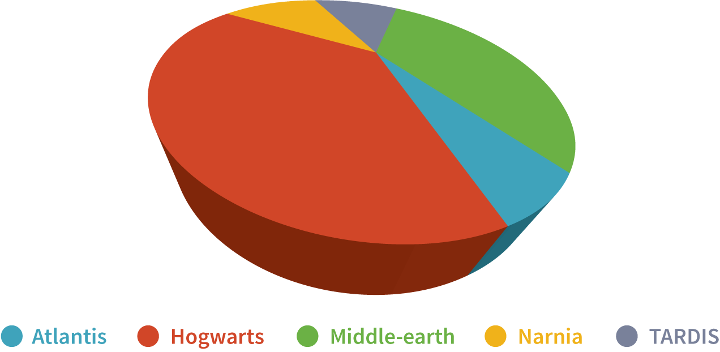
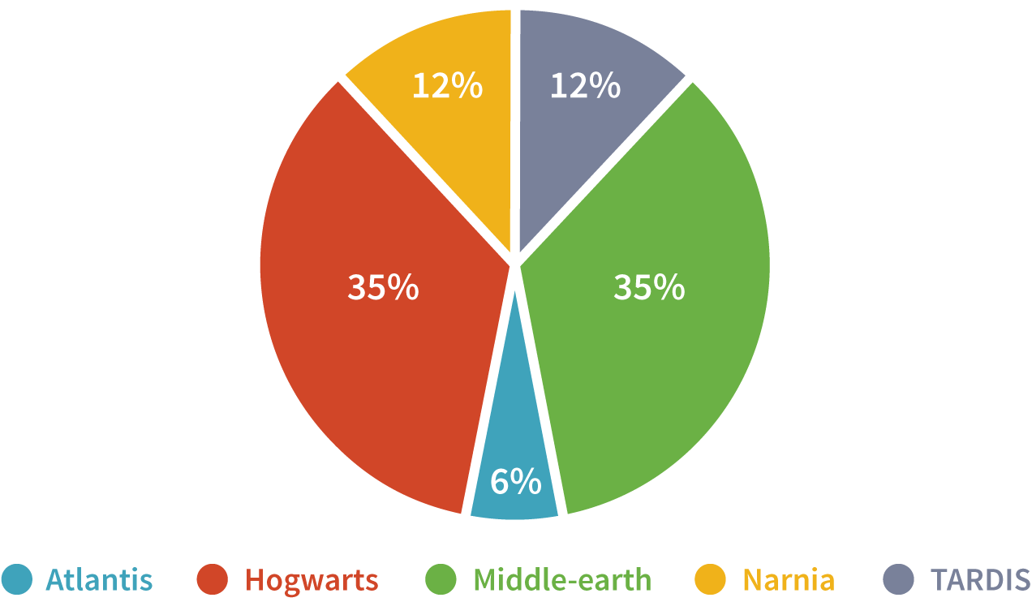
Graphical Integrity: Perspective
Source: Data + Design. Chapter 17: Perception Deception.

Slide 11
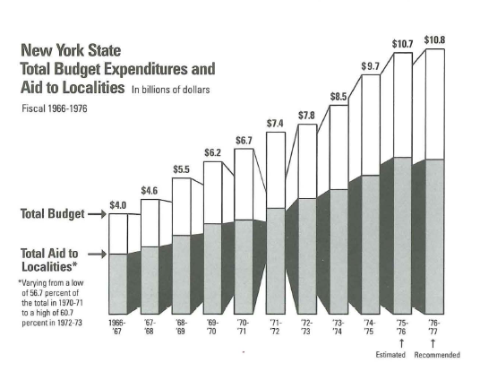
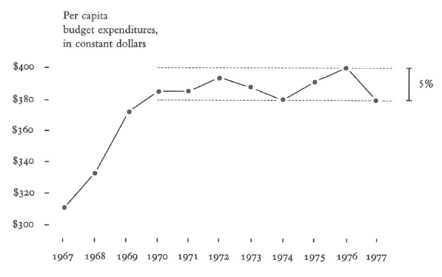
Graphical Integrity: Normalization
Notes:
It’s important to properly normalize your data so as to account for variations that are not germane to your story. But what IS your story? If your story is about absolute budget increase then the 1st graph may be ok.
But maybe the story also needs to take into account population increases in that time span in order to offer a faithful view of the issue. What’s the right answer?
In general though you should consider deflated and normalizes units for displays of money.

Slide 12
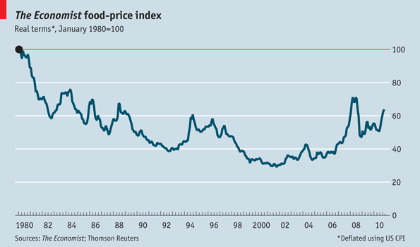
Graphical Integrity: Context
Time of baseline matters: “If the chart had began in, say, 1976 it would look significantly different because January 1980 was when the worst of Carter-era inflation was visible.”
Don’t “quote” data out of context – consider its cropping

Slide 13
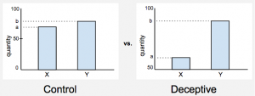
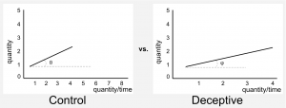
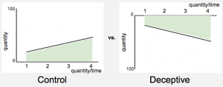
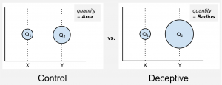
Vis Deception
Truncated axis
Aspect Ratio
Inverted axis
Area Mapping
How Deceptive are Deceptive Visualizations?: An Empirical Analysis of Common Distortion Techniques. Proc. CHI 2015.
Notes:
A recent experiment looked at the extent to which 4 different manipulation strategies were effective in changing people’s perceptions.
We present half of the participants with a deceptive version of the chart and half with the not deceptive one. Then, we ask the same question to both and measure the difference between the two. Let me give you an example.
We show bar charts similar to those shown above and say that they represent the percentage of population with access to drinking water in Willowtown and Silvatown (yes we use fake names, see why in the paper). One version has a truncated axis, the other does not. Then we ask: “How much better are the drinking water conditions in Willowtown as compared to Silvatown?“.
The participants do not have to provide a precise number, rather they have to provide a gross estimation of the effect using a 5-item Likert scale, ranging from “slightly better” to “substantially better“.

Slide 14
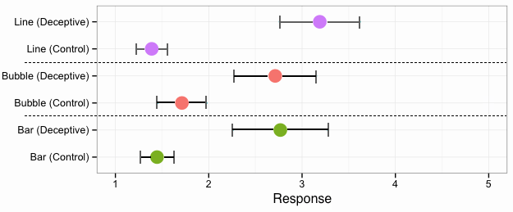
Vis Deception Results
Participants provided a gross estimation of the effect using a 5-item Likert scale, ranging from “slightly better” to “substantially better“.
slightly better
substantially better
Notes:
For each chart the control, that is the chart with not deceptive effect, should lead to a smaller estimate in the response. When I ask you “How much better are the drinking water conditions in Willowtown as compared to Silvatown?” the control chart should show that the difference is not that big.

Slide 15
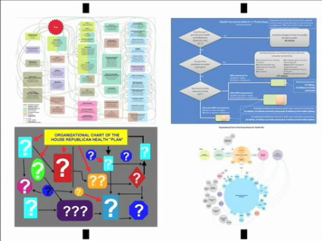
Vis Rhetoric – Chart Wars
https://www.youtube.com/watch?v=tZl-1OHw9MM

Slide 16
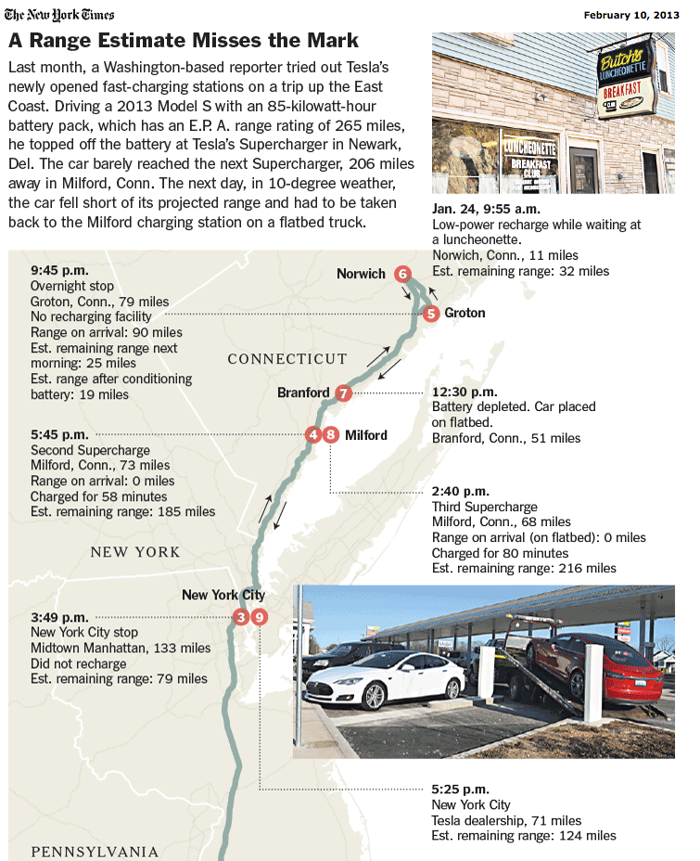
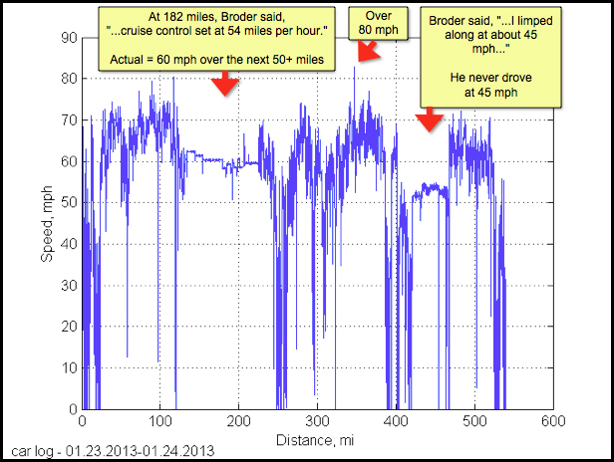
Vis Rhetoric
Notes:
An example of telling different versions of a story with data. Original NYT story, the tesla data, and on the next slide the why axis redesign

Slide 17
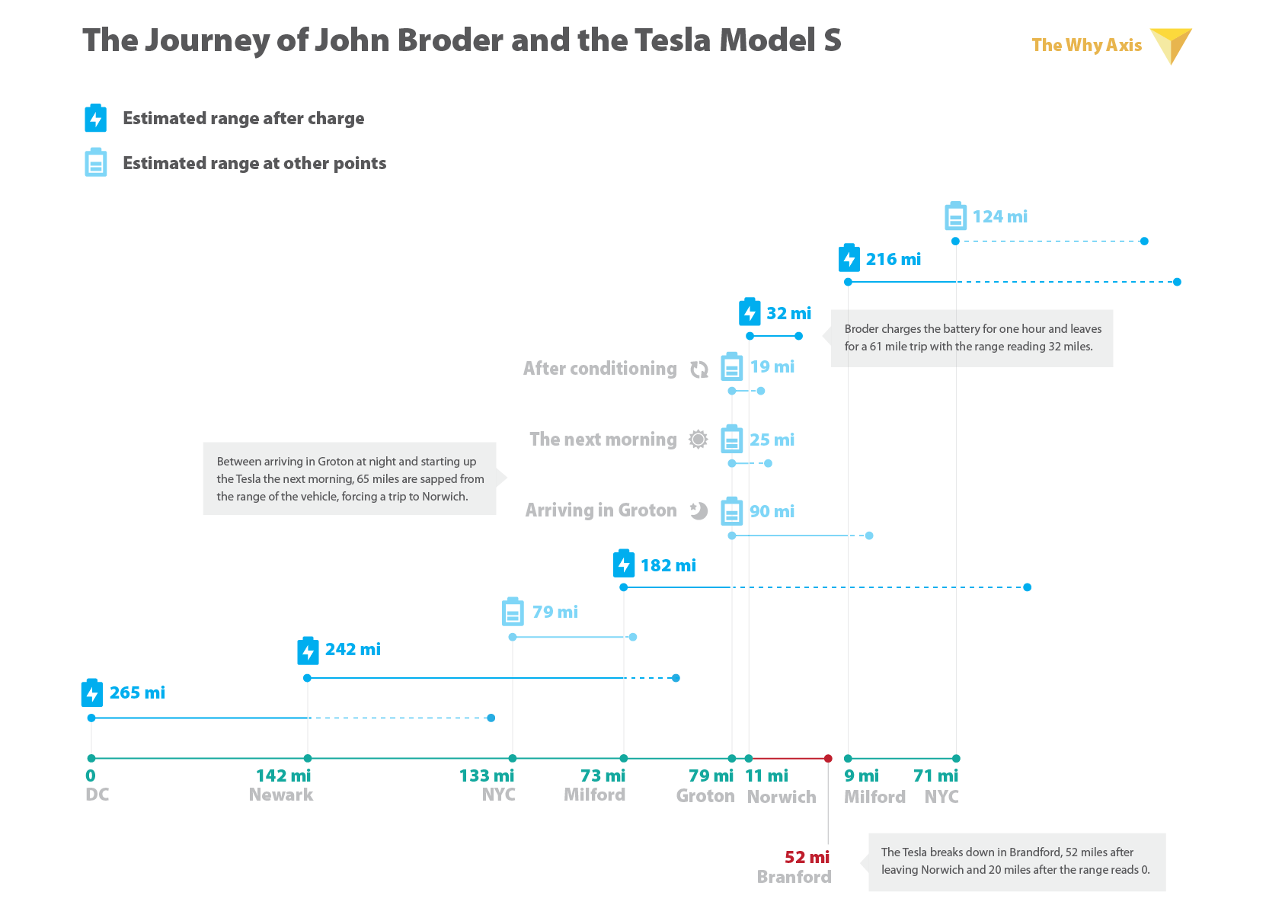
Redesign for Clarity
http://thewhyaxis.info/tesla/

Slide 18
Terminology
Rhetoric
Motivation on part of communicator to gain adherents to a preconceived view or conclusion.
Bias
Systematic encouragement of one outcome or answer over others
Frame
To form or articulate, shape or construct
Notes:
Depending on which term you use there are different connotations: frame is fairly neutral, whereas bias is not. How about rhetoric as a term?
Compare to the term narrative / story, which is also about guiding someone’s attention.

Slide 19
Rhetorical Layers
Data
Includes / excluded variables, outlier removal, aggregation, normalization, ambiguous data definition
Visual Representation
Choice of mapping – can be more efficient, or more lossy
Spatial ordering primacy of reading convention
Annotation
As way of focusing and directing attention as well as framing interpretation, provenance info, uncertainty representation
Interactivity
Navigation capabilities, search / filter / goal suggestions, defaults and default views
Notes:
Can be achieved at different stages of the visualization.

Slide 20
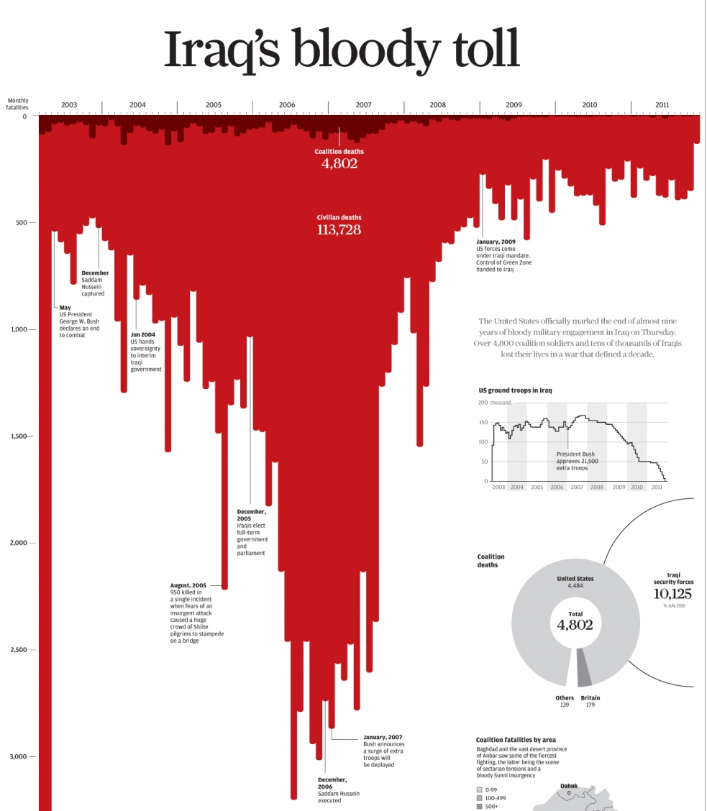
Vis Rhetoric: Connotation
http://www.scmp.com/infographics/article/1284683/iraqs-bloody-toll
Notes:
http://www.scmp.com/infographics/article/1284683/iraqs-bloody-toll
Downward pointing bars looks like blood running down the page.
Other suggestive spatial mappings: left = past, right = future;

Slide 21
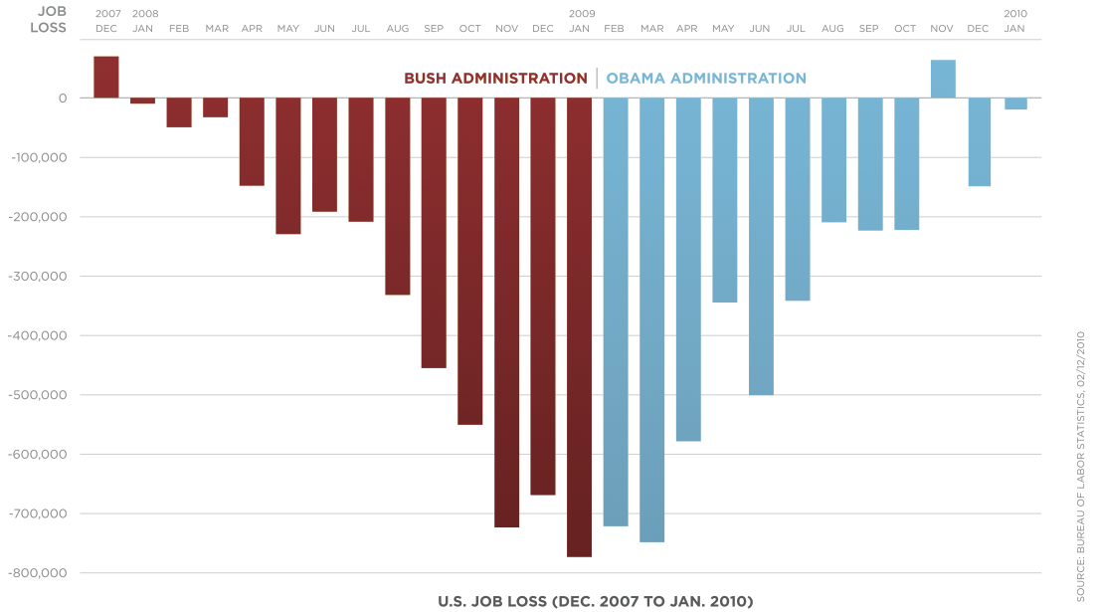
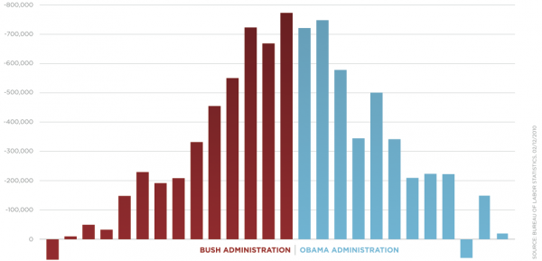
Vis Rhetoric: Orientation
https://eagereyes.org/blog/2012/bikini-chart
Notes:
The downward mapping of bars makes it so it looks like things are going down (getting worse) under bush, but going up (getting better) under obama. This leverages a learned association we have about down and up.
Another tweak here is the fade to darker red at the bottom of the red. This gives it the effect of drying blood.
Also mention this is a good example of a vis criticism from Kosara.

Slide 22
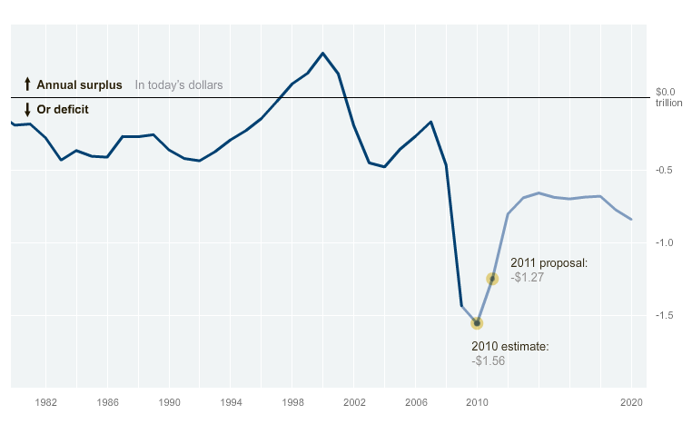
Vis Rhetoric: Animation
http://www.nytimes.com/interactive/2010/02/02/us/politics/20100201-budget-porcupine-graphic.html
Notes:
Animation used to “land” on a view that priviledges that view.

Slide 23
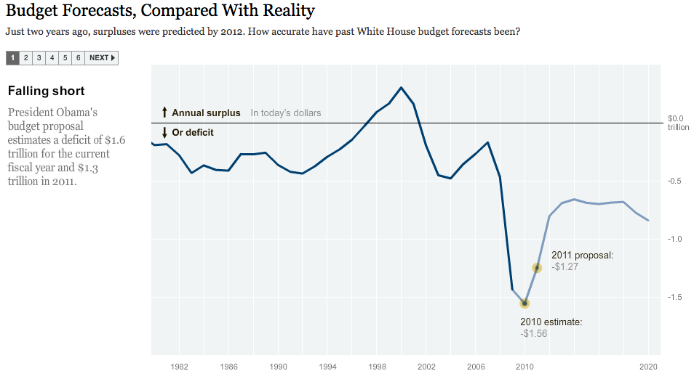
Vis Rhetoric: Rhetorical questions
http://www.nytimes.com/interactive/2010/02/02/us/politics/20100201-budget-porcupine-graphic.html
Notes:
Animation used to “land” on a view that priviledges that view.

Slide 24
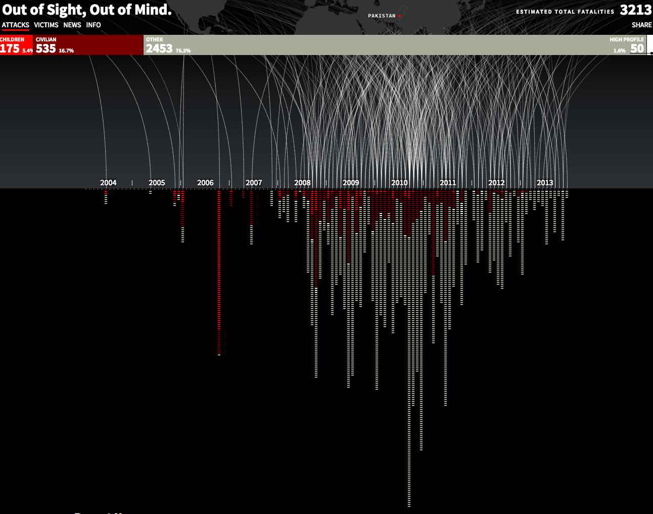
Vis Rhetoric: Metaphor
http://drones.pitchinteractive.com/
Notes:
Metaphor for a drone strike and explosion. Visually mimicking the the thing that you’re actually depicting.

Slide 25
Viewing Codes
Cultural Codes
Social norms or beliefs in a culture that may affect interpretation, e.g. color
Textual Codes
Expectations for positioning of things like titles and sourcing
Aesthetic Codes
What “looks like” a news graphic, and what doesn’t?
Notes:
Codes are a term from semiotics meaning the correlation between representations and meanings.
Culture could also be niches or groups, like scientists, or attorneys. How might we design differently for them?

Slide 26
Critique
Assess success, failure, possibility, causality
Can you suggest a constructive way to improve something?
Should be based on evidence, design principles; not about taste or preference
Discuss the work, don’t attack the creator
Starts from an understanding of the design goal / intent of the work
Notes:
It’s really just about critical thinking applied to vis. Is there deception involved? What kinds of rhetorical techniques are being applied?
You need to know goal b/c otherwise you don’t really know which way is up

Slide 27
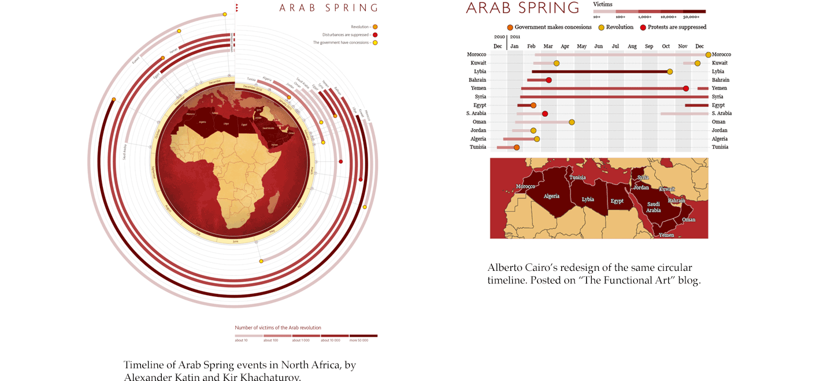
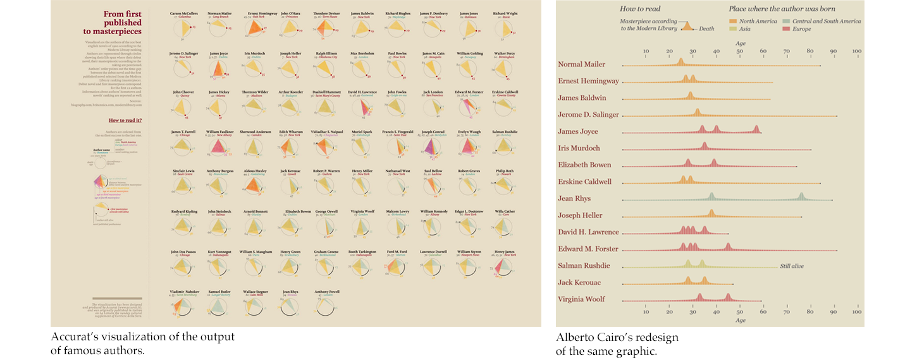
Critique by Redesign
https://medium.com/@hint_fm/design-and-redesign-4ab77206cf9#.e3ikpzeq1
Notes:
Can be useful to express alternative encodings.
BUT: keep in mind you may not be aware of the intent or goal of the original. Perhaps there were hidden constraints you don’t know about.
Take the 2nd example in moving from a radial mapping to linear. There was a lot of controversy on twitter. Though the linear mapping may have been more accurate, the radial mapping was seen as more aesthetic. You have to be aware that such critique happens in public.

Slide 28
Critique by Redesign
What are some of the drawbacks of critique by redesign?
You know the “answer” already
You know which variables matter and how to focus attention
You might not know the intent or constraints of the original
Public critique can result in context collapse
What are best practices for critique by redesign?
Be explicit about goal
Be honest about simplifying assumptions
Be sure to note positive aspects too
https://medium.com/@hint_fm/design-and-redesign-4ab77206cf9#.e3ikpzeq1

Slide 29
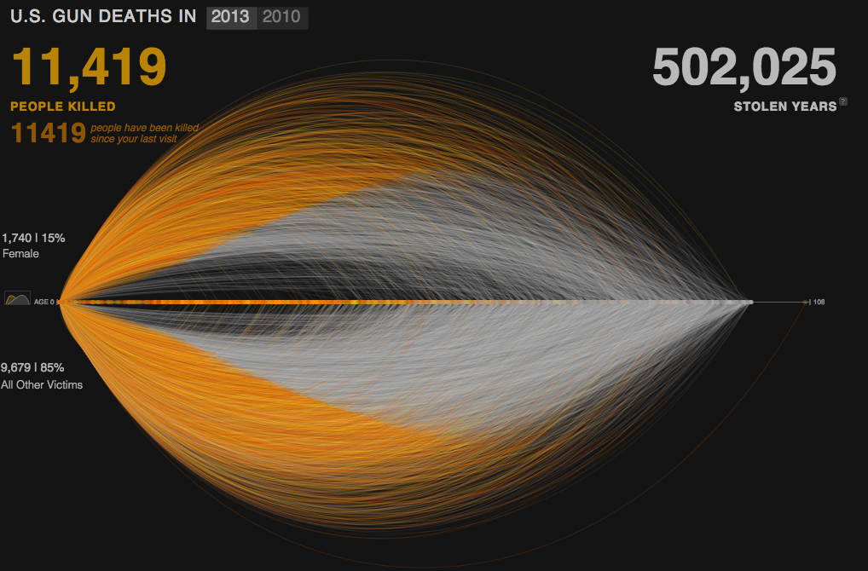
An Example
http://guns.periscopic.com/?year=2013
Notes:
http://guns.periscopic.com/?year=2013

Slide 30
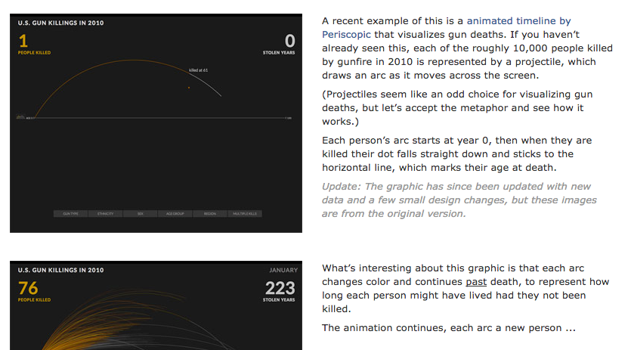
An Example Critique
Jonathan Corum. http://style.org/deleted/

Slide 31
Critique Exercise
Let’s practice!
Everyone get in a group and find a visualization online for critique
Assess success, failure, possibility, causality
Can you suggest a constructive way to improve something?
Or, reverse critique, suggest ways to make it worse!
Should be based on evidence, design principles; not about taste or preference
Discuss the work, don’t attack the creator
Starts from an understanding of the design goal / intent of the work
Does your critique share that goal, or have a different goal? What’s success?
Notes:
It’s really just about critical thinking applied to vis. Is there deception involved?
You need to know goal b/c otherwise you don’t really know which way is up
Spend 25-30 mins finding a vis online with some complexity and doing a critique that you will present back to the class. 5 min presentation each.

Slide 32
Questions?

